Slide 1
Market Data Collection and Analysis Tool
MIDS - W251 Final Project, U.C. Berkeley
Amit Tyagi, Cynthia Hu, John Tabbone,
Matthew Holmes, Surya Nimmagadda
12/18/2017

Slide 2
Vision
New Financial Market Data Collection and Analysis Tool
– Extract Insights From Real-Time Stock Data and Various Historical Data
Limitations of most market data charts
Incomplete sample data
Focus on close price
Lack of summarized statistics
MaDCaAt
Half library and half psudo-real-time analytics tool
Stores historic daily sales activity for a number of symbols and provide visualization and forecast of the stock
Using python interface, a user can formulate statistical theories about market behavior

Slide 3
Architecture

Slide 4
MaDCAT
Data Sources
Real-time data
Historic data
Project Github

Slide 5
Data Source
http://www.dxfeed.com
https://www.alphavantage.co
http://www.quandl.com

Slide 6
Real-Time Data
Data Ingestion
Cassandra DB
Visualization in Jupyter
Cynthia – please add here

Slide 7
Real-Time Data
Data Ingestion
Cassandra DB
Visualization in Jupyter
Cynthia – please add here

Slide 8
Real-Time Data
Data Ingestion
Cassandra DB
Visualization in Jupyter

Slide 9
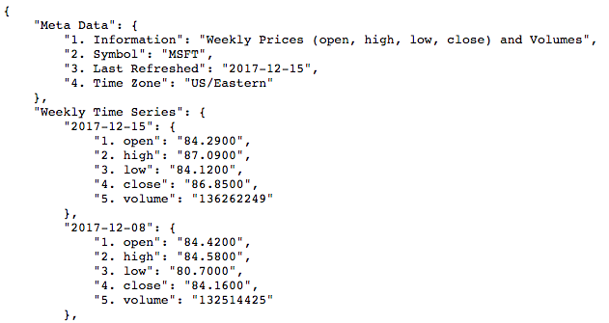
Historic Data
Data Ingestion
Elastic Search DB
Kibana Visualization
Weekly Data from alphavantage
https://www.alphavantage.co/query?function=TIME_SERIES_WEEKLY&symbol=MSFT&apikey=demo

Slide 10
Historic Data
Data Ingestion
Elastic Search DB
Kibana Visualization
Fetch the data from alphavantage in csv
wget -O aapl.csv https://www.alphavantage.co/query?function=TIME_SERIES_DAILY_ADJUSTED&symbol=AAPL&&outputsize=full&apikey=YMKEPIY3AWI2CV5G&datatype=csv
Preprocess the data to include additional fields
Load into elasticsearch
elasticsearch_loader --index stocksfinal --type tech csv aapl.csv msft.csv ibm.csv

Slide 11
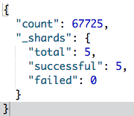
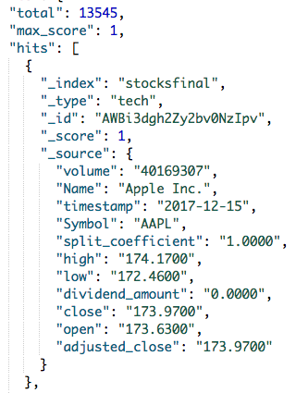
Historic Data
Data Ingestion
Elastic Search DB
Kibana Visualization

Slide 12
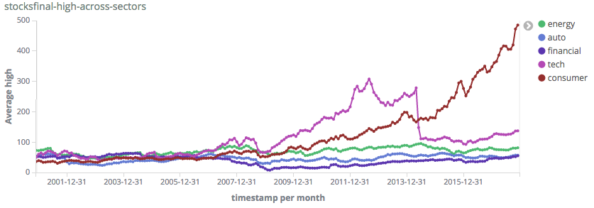
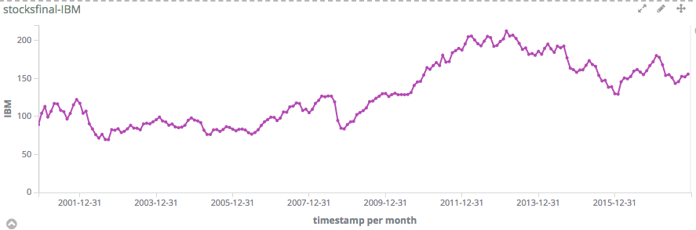
Historic Data
Data Ingestion
Elastic Search DB
Kibana Visualization

Slide 13

Challenges
Data Source
Free tools provides limited data
Expensive to get rich financial market data easily
Tool Integration
Architecture partially depends on the data source
Load different formats of data into database
Big Scope
Start the project with a big scope and ambition
Need to narrow down and move forward step by step

Slide 14
Demo
Jupyter Notebook
Cassandra DB
Setup Details
Kibana
Elastic Search DB
Setup Details

Slide 15



Q & A Thank you!

